Slide 1
Where are Earthquakes Happening?
By Gabe Calderon
3.14.23

Slide 2
Where are most earthquakes happening?
We will analyze:
1. Which Continents?
2. Which Countries?
3. Which Months?

Slide 3
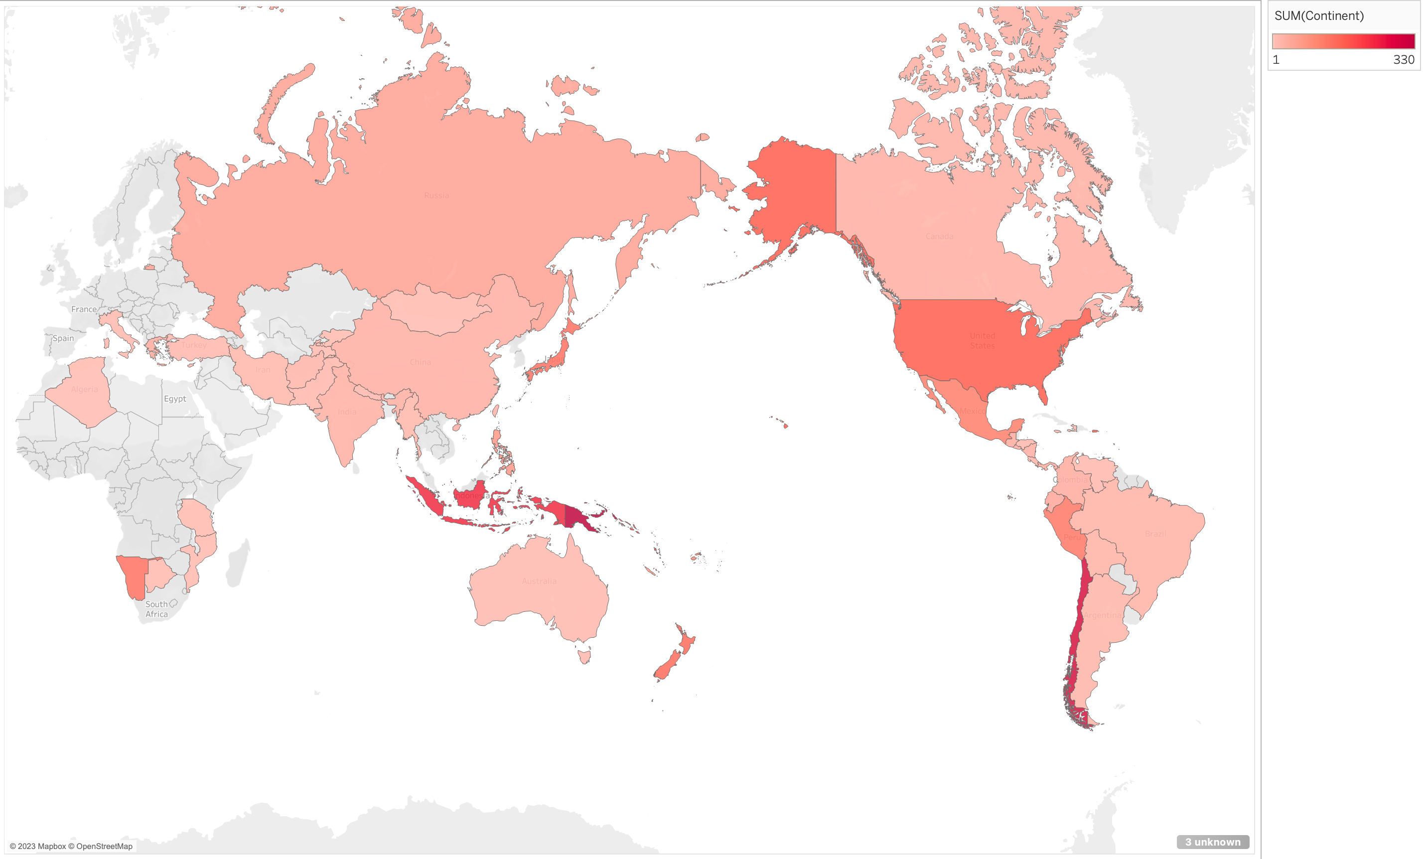
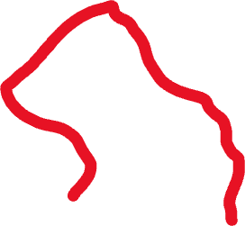
Statistically, most earthquakes occur in the circum-Pacific seismic belt
81 percent of our planet's largest earthquakes occur near “Ring of Fire”
- “Where Do Earthquakes Occur?” Where Do Earthquakes Occur? | U.S. Geological Survey, U.S. Department of the Interior, https://www.usgs.gov/faqs/where-do-earthquakes-occur.
This dataset contains records of 782 earthquakes from 1/1/2001 to 1/1/2023
- Chauhan, Chirag. “Earthquake Dataset.” Kaggle, 26 Feb. 2023, https://www.kaggle.com/datasets/warcoder/earthquake-dataset.
Ring of Fire

Slide 4
Total # of Earthquakes by Continent
Most earthquakes occurred in Asia (299)

Slide 5
Total # of Earthquakes by Country
Most earthquakes occur in Indonesia (119)

Slide 6

Earthquake Correlation Data
Based on these findings, we have concluded that there is a moderate correlation between the date and earthquakes that also resulted in tsunami
 | Continent | magnitude | nst | dmin | gap | depth | cdi | mmi | tsunami | sig | date_time
Continent | 1
magnitude | 0.03069794 | 1
nst | -0.19858 | 0.11311434 | 1
dmin | 0.22055997 | -0.0914025 | -0.5293713 | 1
gap | 0.0627418 | -0.1106261 | -0.1188119 | -0.0219328 | 1
depth | 0.06541326 | 0.03064441 | -0.1219816 | 0.16854598 | -0.1119122 | 1
cdi | -0.0438093 | 0.20954922 | -0.1754166 | 0.00655371 | 0.09814321 | -0.0978909 | 1
mmi | -0.1552621 | 0.28555187 | 0.1604168 | -0.2990739 | -0.0157231 | -0.5044388 | 0.31793714 | 1
tsunami | 0.28614874 | -0.004726 | -0.6002312 | 0.40075166 | 0.11636023 | 0.05681422 | 0.16026564 | -0.1473627 | 1
sig | -0.0700765 | 0.51587073 | -0.0301003 | -0.0953177 | 0.11428546 | -0.0886673 | 0.47978827 | 0.44242325 | -0.0154996 | 1
date_time | 0.19032156 | -0.0560017 | -0.686451 | 0.52986414 | 0.19709382 | 0.17747442 | 0.42476706 | -0.2135706 | 0.64618754 | 0.12476177 | 1

Slide 7
Deeper Analysis of Tsunami and Date Correlation
November has more Tsunamis caused by earthquakes than any other month.

Slide 8
Summary
Most earthquakes occur in the Ring of Fire.
The earthquake totals of Asia plus Oceania see more earthquakes than all the other continents combined.
The countries that had the most earthquakes are in this region (Indonesia, Papua New Guinea, Chile, United States of America, Japan, Vanuatu).
The moderate correlation between dates and tsunamis caused by earthquakes show the weakest months are February and December.

Slide 9
Works Cited
Chauhan, Chirag. “Earthquake Dataset.” Kaggle, 26 Feb. 2023, https://www.kaggle.com/datasets/warcoder/earthquake-dataset.
“Where Do Earthquakes Occur?” Where Do Earthquakes Occur? | U.S. Geological Survey, U.S. Department of the Interior, https://www.usgs.gov/faqs/where-do-earthquakes-occur.

